Slide 1
Areas of Assessment
Livelihood zones
Framework

Slide 2
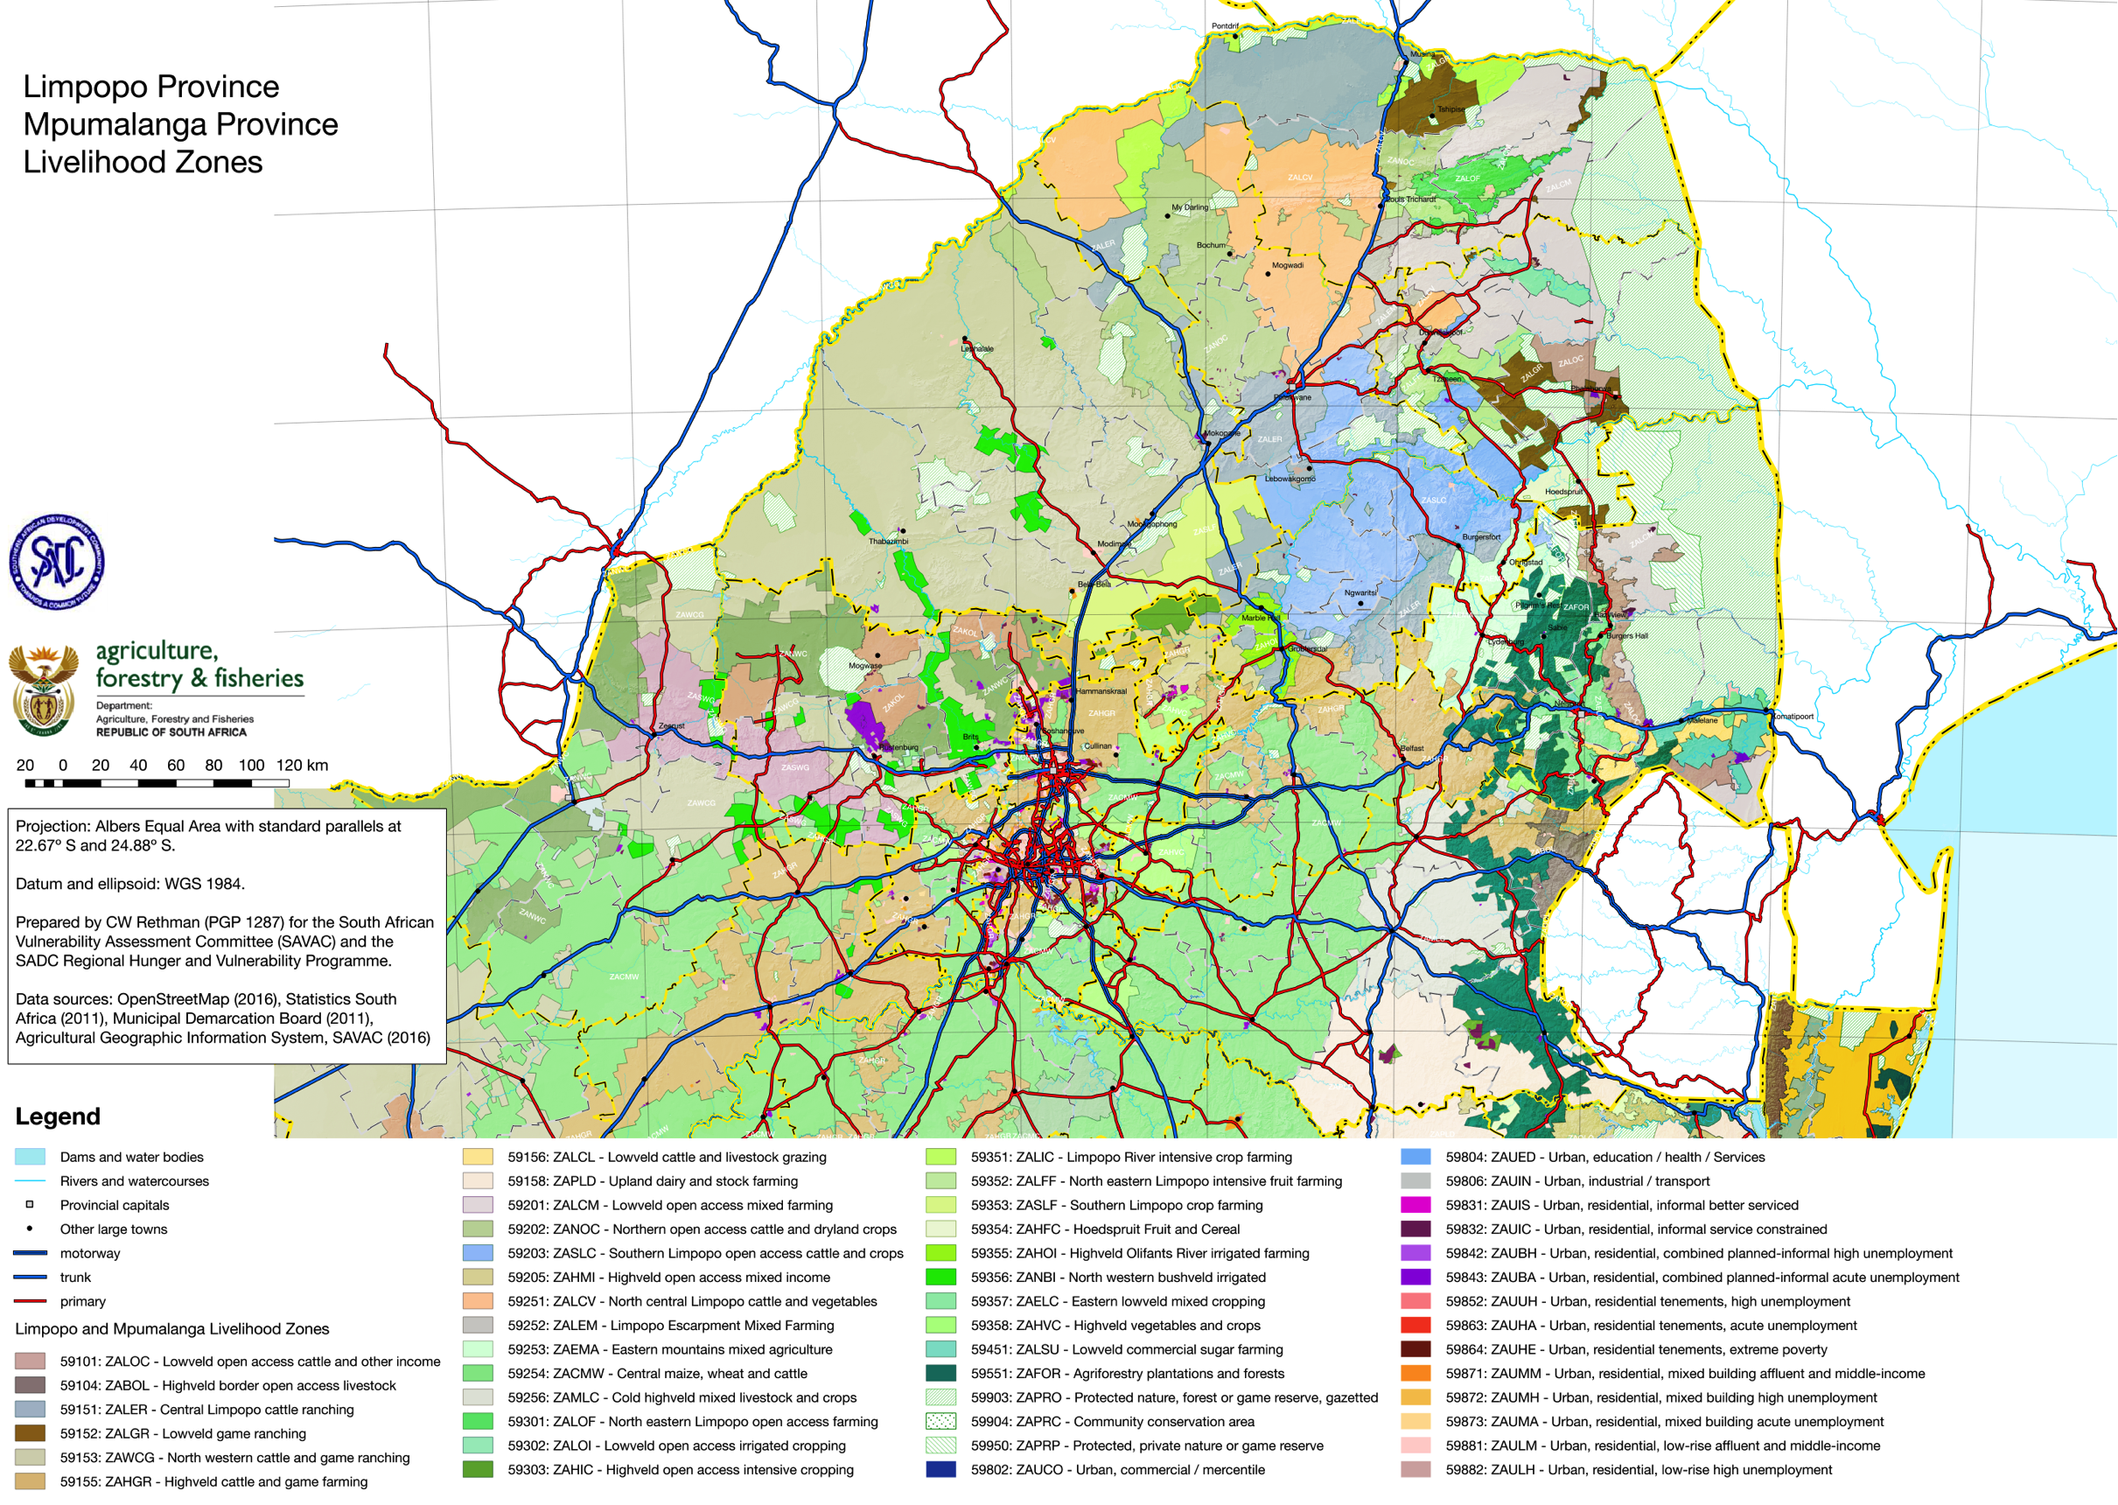

Slide 3
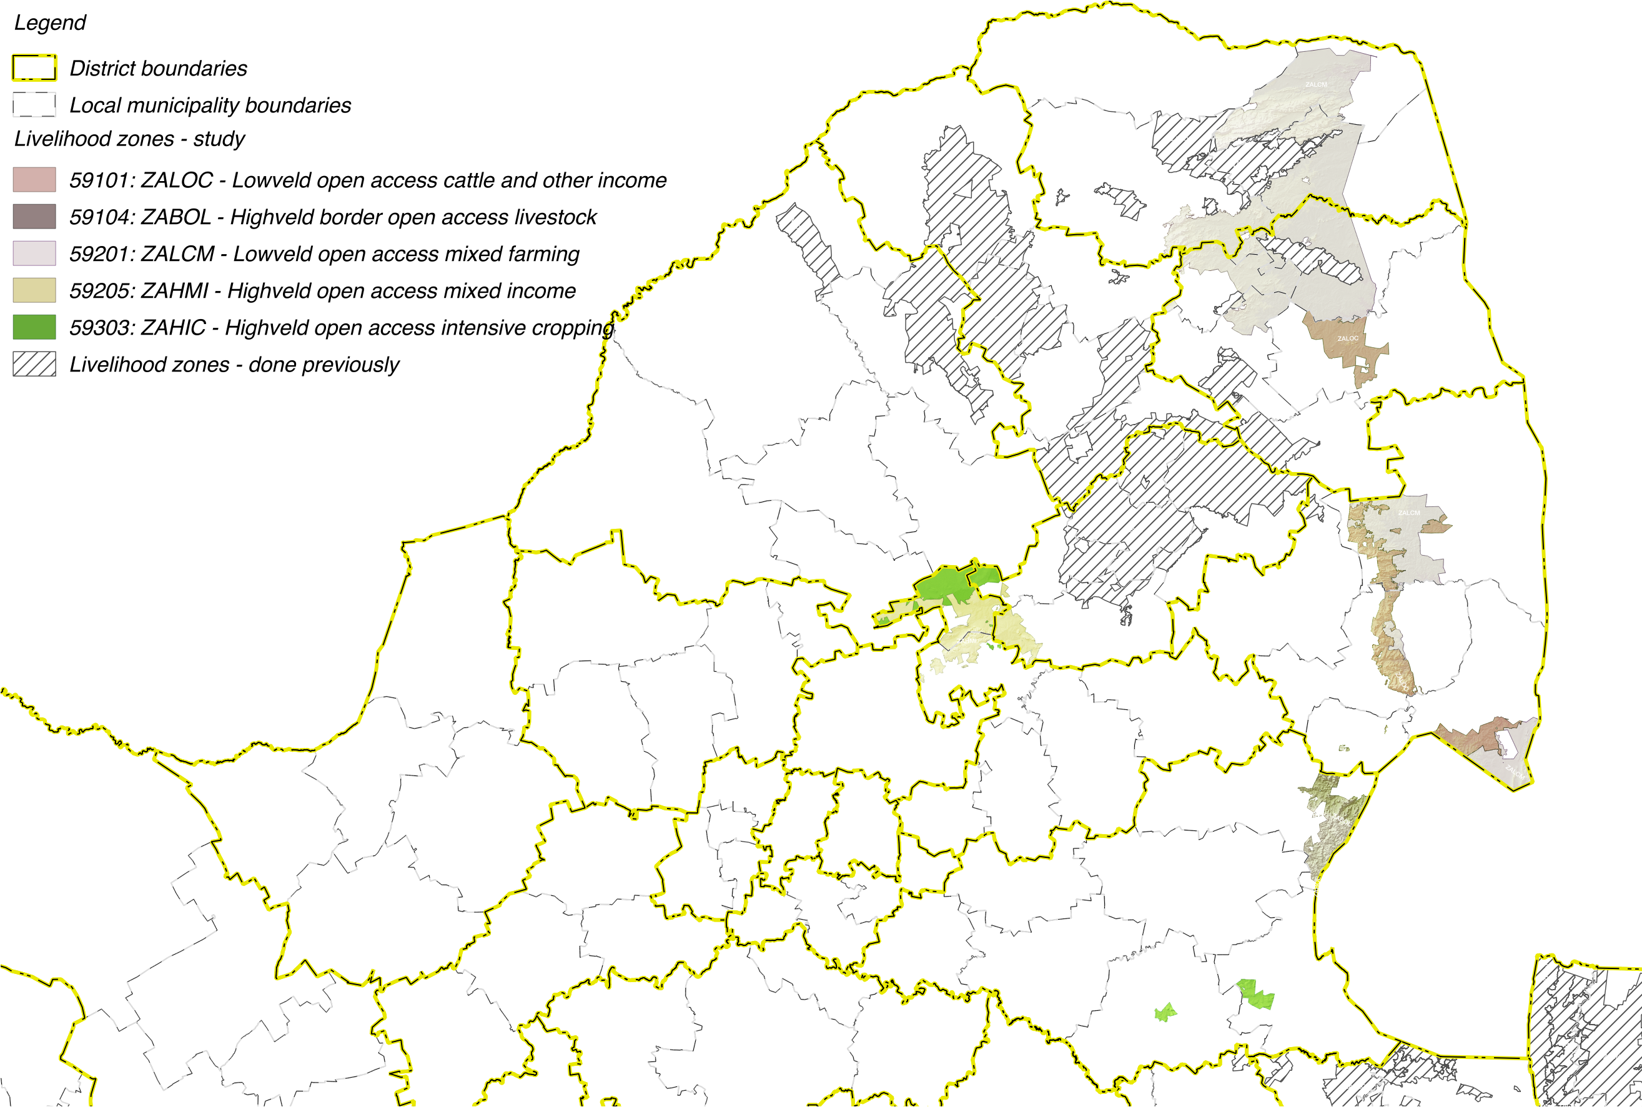

Slide 4
Livelihoods Findings:
Wealth Descriptions and Wealth Breakdowns

Slide 5
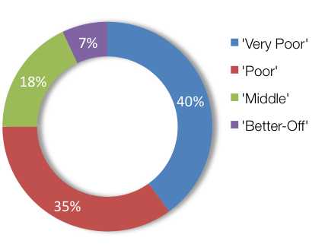
Wealth Breakdowns & Descriptions: ZALCM – Lowveld Open Access Mixed Farming (59201)
WEALTH GROUP | LIVESTOCK (cattle) | FARM SIZE (ha) | MAIN INCOME
Very Poor | 0 – 7 [4] | 1.0 | Grants
Poor | 3 – 10 [5] | 1.5 | Grants
Middle | 10 – 50 [20] | 2.0 | Employ
Better Off | 15 – 200 [50] | 2.0 | Employ/agric

Slide 6
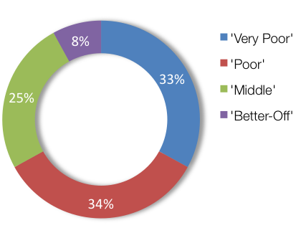
Wealth Breakdowns & Descriptions: ZAHIC – Highveld Open Access Intensive Cropping (59303)
WEALTH GROUP | LIVESTOCK (cattle) | FARM SIZE (ha) | MAIN INCOME
Very Poor | 0 | 0.75 | Grants
Poor | 0 – 4 [2] | 1.0 | Grants
Middle | 0 – 15 [10] | 1.2 | Employ
Better Off | 5 – 60 [30] | 2.0 | Employ/agric

Slide 7
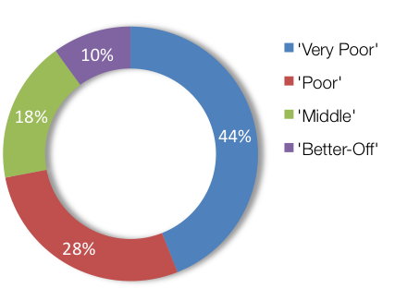
Wealth Breakdowns & Descriptions: ZABOL – Highveld border open access livestock (59104)
WEALTH GROUP | LIVESTOCK (cattle) | FARM SIZE (ha) | MAIN INCOME
Very Poor | 0 | 0.25 | Grants
Poor | 0 – 4 [3] | 0.5 | Grants
Middle | 5 – 13 [10] | 1.0 | Employ
Better Off | 10 – 25 [20] | 2.0 | Employ

Slide 8
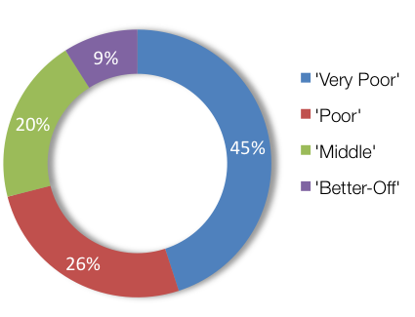
Wealth Breakdowns & Descriptions: ZALOC – Lowveld Open Access Cattle and Other Income (59101)
WEALTH GROUP | LIVESTOCK (cattle) | FARM SIZE (ha) | MAIN INCOME
Very Poor | 0 | 0.2 | Grants
Poor | 0 – 4 [2] | 0.3 | Grants
Middle | 0 – 15 [10] | 0.3 | Employ
Better Off | 5 – 60 [30] | 4.0 | Employ

Slide 9
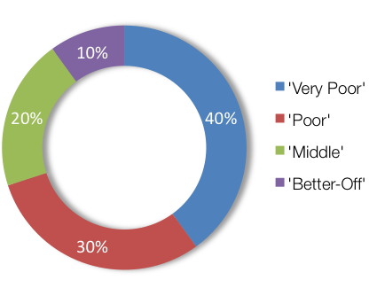
Wealth Breakdowns & Descriptions: ZAHMI – Highveld Open Access Mixed Income (59205)
WEALTH GROUP | LIVESTOCK (cattle) | FARM SIZE (ha) | MAIN INCOME
Very Poor | 0 | 0.5 | Grants
Poor | 0 – 7 [3] | 0.5 | Grants
Middle | 6 – 10 [8] | 0.5 | Employ
Better Off | 10 – 20 [15] | 0.5 | Employ

Slide 10
Livelihoods Findings:
Sources of Food and Income

Slide 11
Seasons, consumption years, reference year

Slide 12
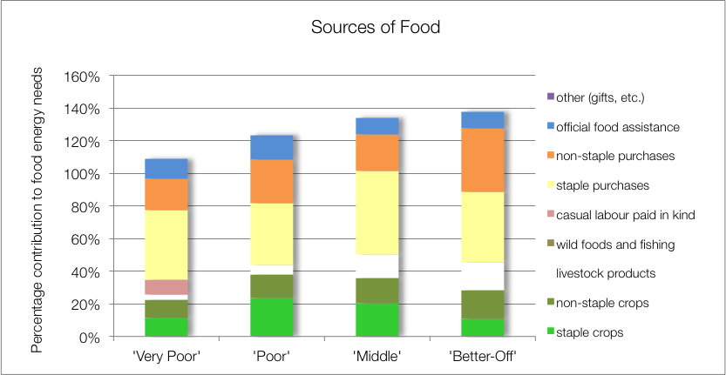
Source of Food: ZALCM – Lowveld Open Access Mixed Farming (59201)
Key findings:
Crops (maize, beans, w.melon, gnuts, roundnuts & pumpkin) important (23%-38%)
Food purchase >50%
School feeding to all WGS
Notes:
DON’T CLICK TOO FAST THROUGH THE ANIMATIONS!!

Slide 13
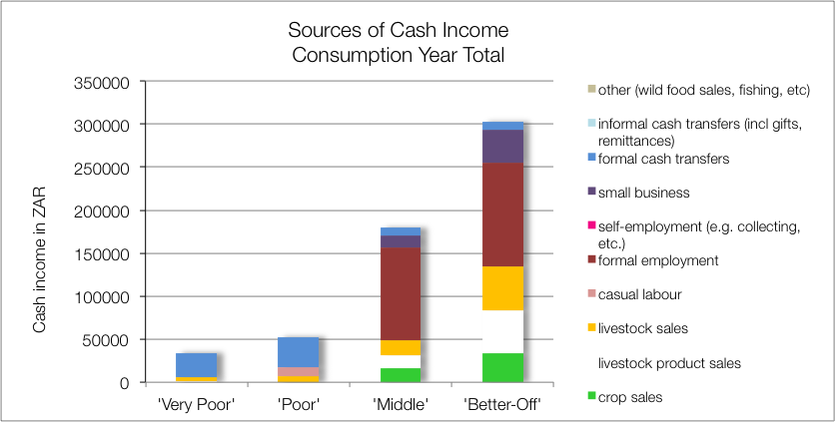
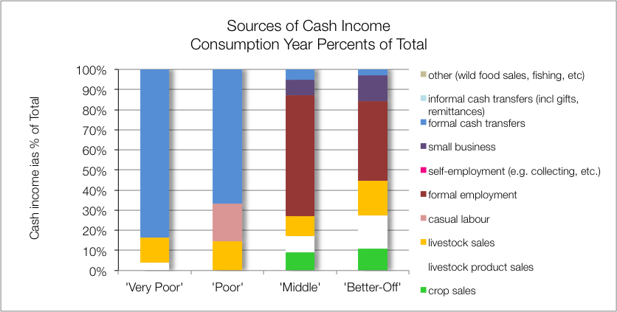
Source of Cash: ZALCM – Lowveld Open Access Mixed Farming (59201)
Key findings:
Agriculture (crops and livestock) income high (up to 45%)
Formal employemnt (BO & M)
Grants (VP & P)
Casual labour (P)
Notes:
DON’T CLICK TOO FAST THROUGH THE ANIMATIONS!!
Explain the difference between the two graphs: the upper is the absolute values (in Rands) and the lower is proportions of totals (in %).

Slide 14
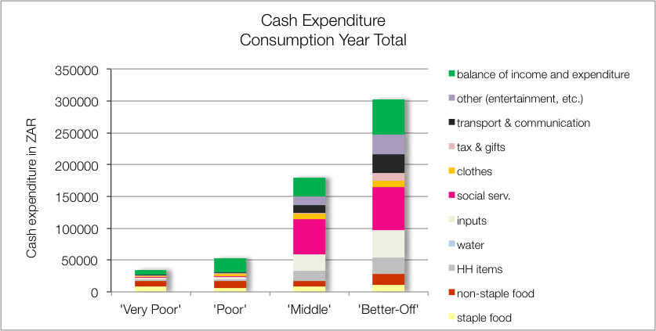
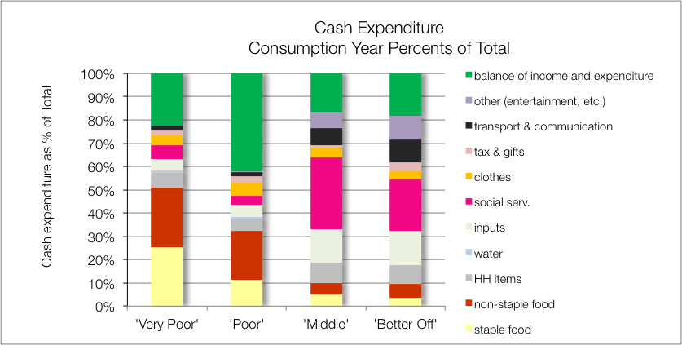
Source of Cash: ZALCM – Lowveld Open Access Mixed Farming (59201)
Key findings:
Soc Services (school, health), M ~30% & BO ~22%
Inputs (incl labour), M & BO ~15%
Food, VP >50% & P >30%)

Slide 15
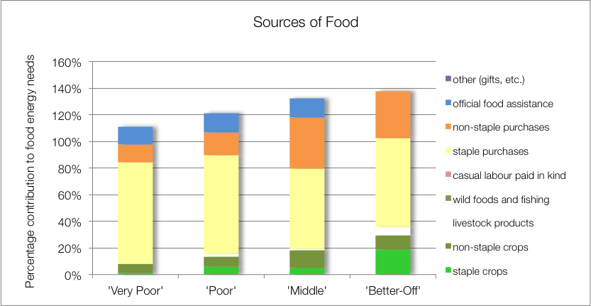
Sources of Food: ZAHIC – Highveld Open Access Intensive Cropping (59303)
Key findings:
Crops (maize, beans, w.melon & pumpkin) important, M 18% & BO 29%
Food purchase >90%
School feeding to VP, P & M (BO at fee school)

Slide 16
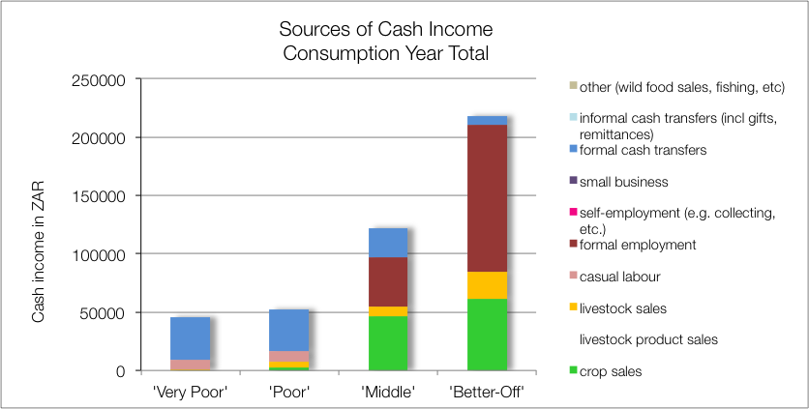
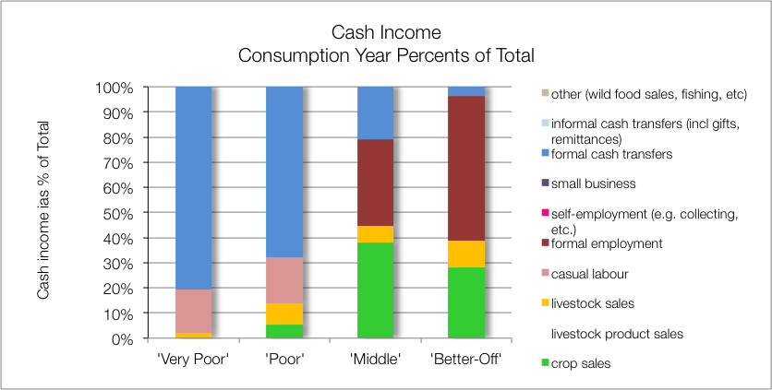
Sources of Cash: ZAHIC – Highveld Open Access Intensive Cropping (59303)
Key findings:
Agriculture—crop (cotton & sunflower) and livestock sales high for M (45%) & BO (38%)
Formal employemnt (BO & M)
Grants (VP & P)
Casual labour (P)

Slide 17
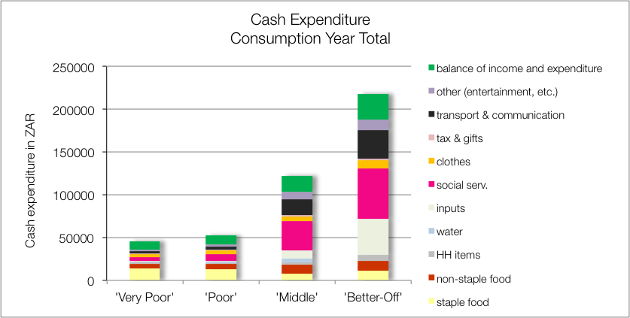
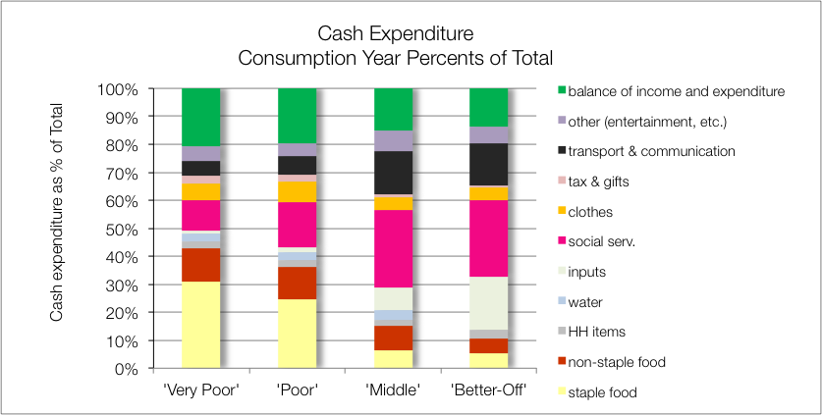
Sources of Cash: ZAHIC – Highveld Open Access Intensive Cropping (59303)
Key findings:
Soc Services (school, health), M & BO ~28%
Inputs (incl labour), M ~10% & BO ~19%
Food, VP >40% & P >30%)

Slide 18
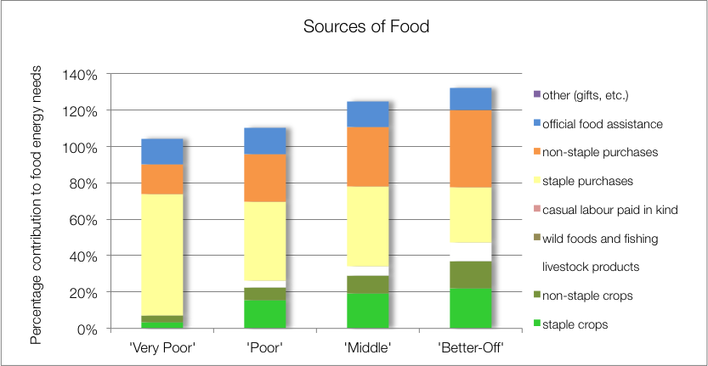
Sources of Food: ZABOL – Highveld border open access livestock (59104)
Key findings:
Crops (maize, gr maize, cabbage, beans, s.potatoes, gnuts, spinach) important to P, M & BO (22%-37%)
Food purchase >70%
School feeding to all WGS

Slide 19
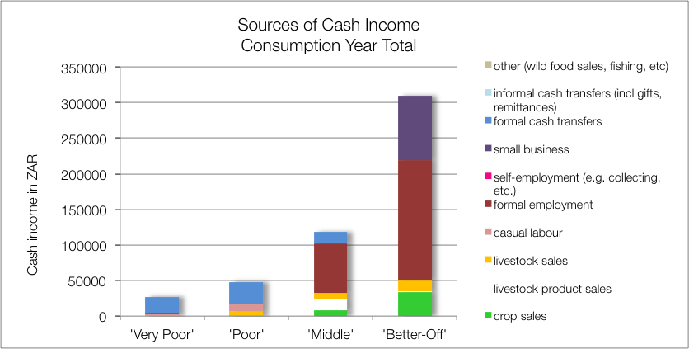
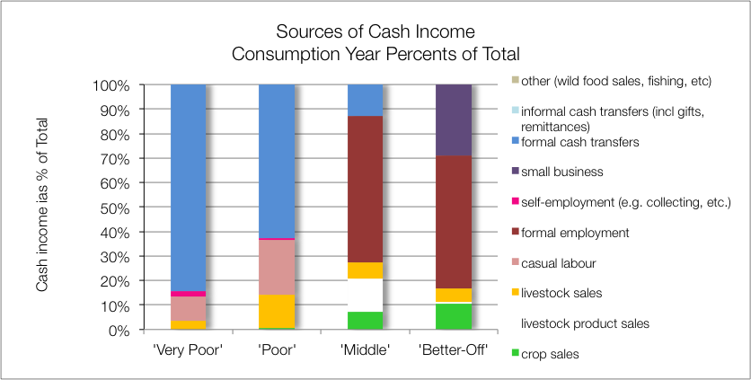
Sources of Cash: ZABOL – Highveld border open access livestock (59104)
Key findings:
Agriculture (crops and livestock) income: M ~20% & BO ~11%
Formal employemnt: M ~60% & BO ~55%
Small business: 29% (BO)
Grants (VP & P)
Casual Labour (VP & P)

Slide 20
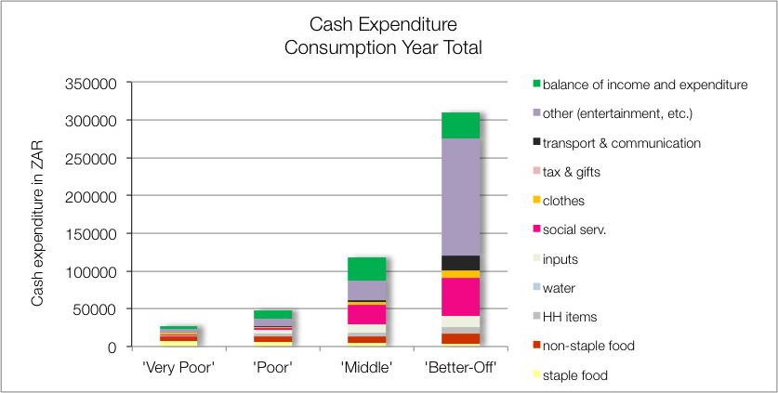
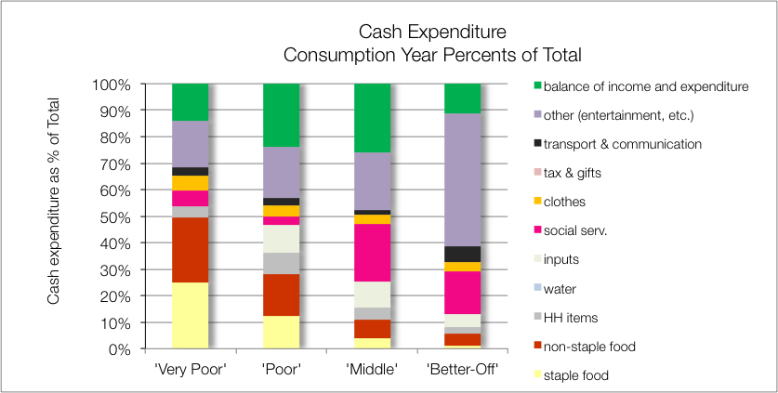
Sources of Cash: ZABOL – Highveld border open access livestock (59104)
Key findings:
Soc services (school & health), M ~24% & BO ~19%
Food, VP ~50% & P ~30%
Other (entertainment, etc.): VP, P & M 17% to 22%; BO ~47%

Slide 21
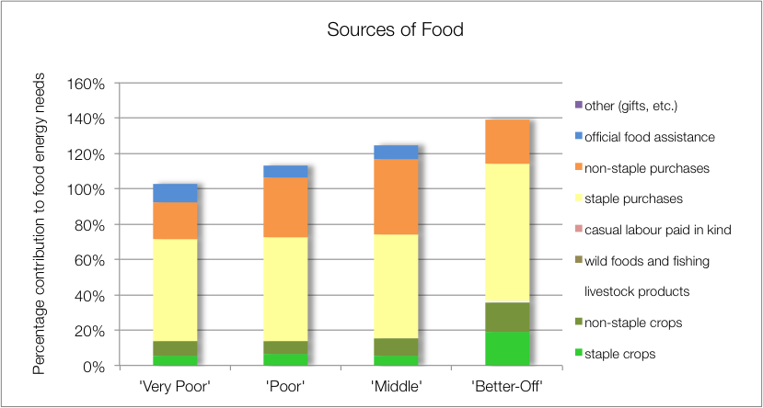
Sources of Food: ZALOC – Lowveld Open Access Cattle and Other Income (59101)
Key findings:
Crops (maize & gnuts) signifiant for BO only (~36%)
Food purchase >79%
School feeding to VP, P & M (BO at fee school)

Slide 22
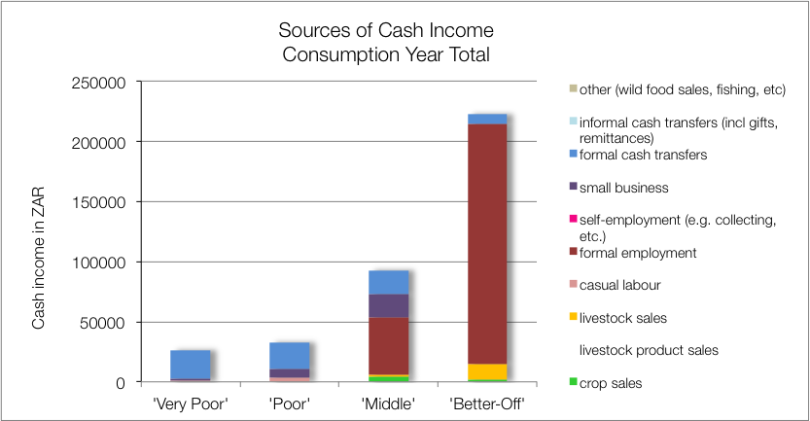
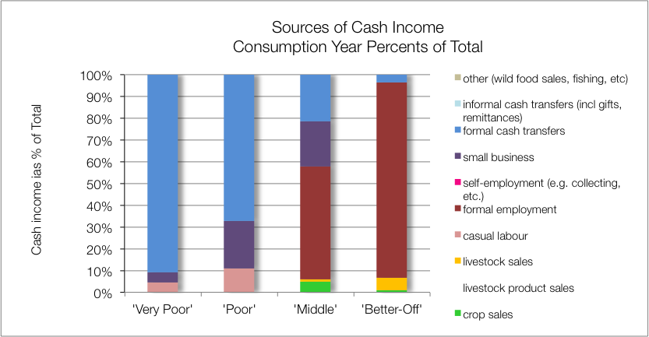
Sources of Cash: ZALOC – Lowveld Open Access Cattle and Other Income (59101)
Key findings:
Formal employemnt (M ~52% & BO ~90%)
Petty trading (P & M, ~21%)
Grants (VP & P)
Casual labour (P)

Slide 23
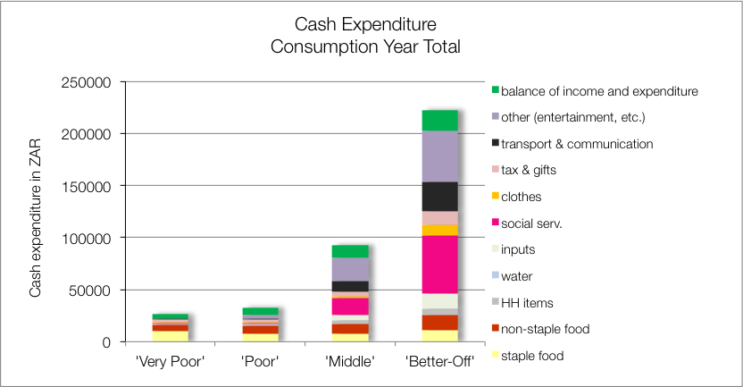
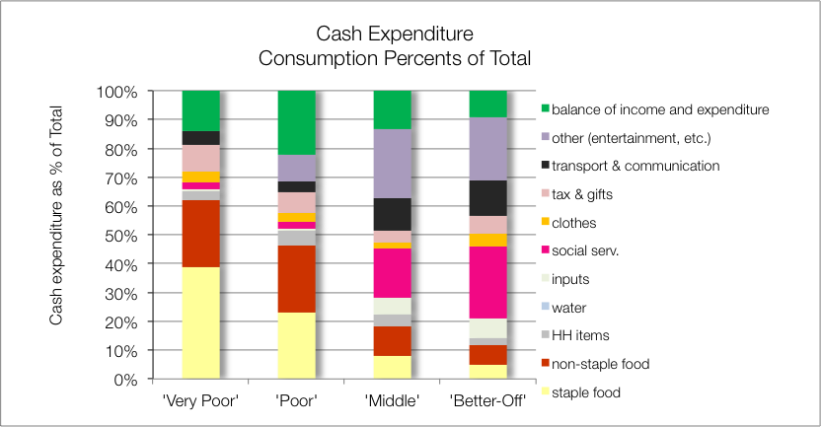
Sources of Cash: ZALOC – Lowveld Open Access Cattle and Other Income (59101)
Key findings:
Soc services (school & health), M ~24% & BO ~19%
Food, VP ~50% & P ~30%
Other (entertainment, etc.): VP, P & M 17% to 22%; BO ~47%

Slide 24
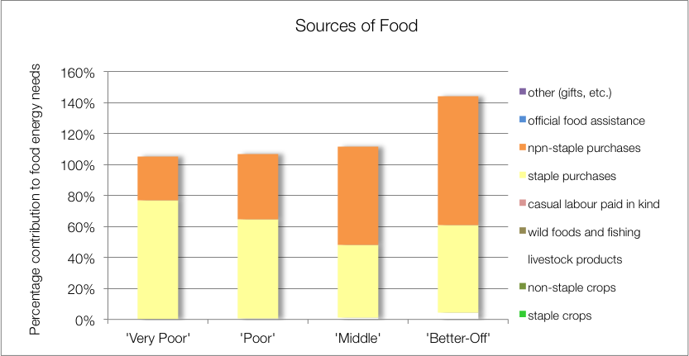
Sources of Food: ZAHMI – Highveld Open Access Mixed Income (59205)

Slide 25
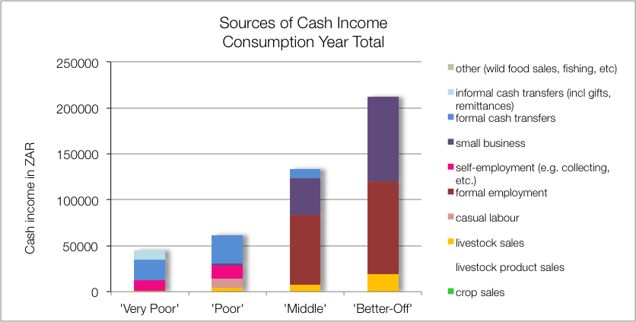
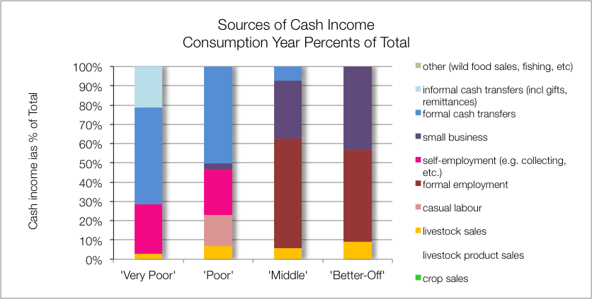
Sources of Cash: ZAHMI – Highveld Open Access Mixed Income (59205)

Slide 26
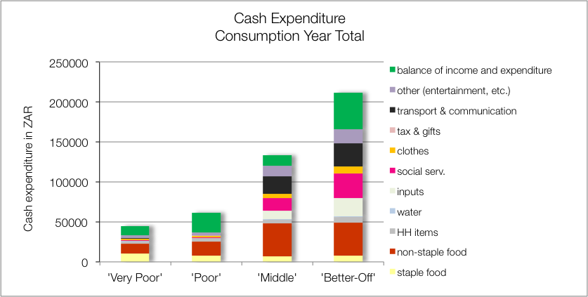
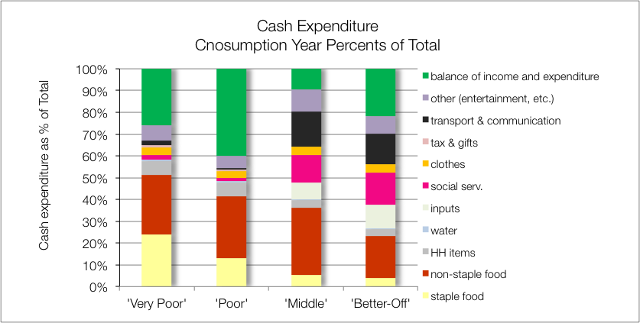
Sources of Cash: ZAHMI – Highveld Open Access Mixed Income (59205)

